Slide 1
SENG204-Software Security Engineering
Module-1: Software Security Fundamentals
Week-1 and 2:
Security a Software Issue
Week-3 and 4:
What Makes Software Secure?

Slide 2
What Makes Software Secure
Introduction
To answer the question, “What makes software secure?” it is important to understand the meaning of software security in the broader context of software assurance.

Slide 3
What Makes Software Secure
Introduction
As described previously, software assurance is the domain of working toward software that exhibits the following qualities:
Predictable execution, whereby there is justifiable confidence that the software, when executed, functions as intended.

Slide 4
What Makes Software Secure
Introduction
Conformance, whereby a planned and systematic set of multidisciplinary activities ensure that software processes and products conform to their requirements, standards, and procedures
Trustworthiness, whereby no exploitable vulnerabilities or weaknesses exist, either of malicious or unintentional origin

Slide 5
What Makes Software Secure
Introduction
We will focus primarily on the dimension of trustworthiness—that is, which properties can be identified, influenced, and asserted to characterize the trustworthiness, and thereby the security, of software.
We examine here the properties of software that make it secure, and discuss how other desirable traits of software can also contribute to its security.

Slide 6
What Makes Software Secure
Introduction
A secure software does not only functions in the intended manner, but also this “intended manner” will not compromise the security and other required properties of the software, its environment, or the information it handles.

Slide 7
Core Properties of Secure Software
Attributes of Security as a Property of Software
Several lower-level fundamental properties may be seen as attributes of security as a software property:

Slide 8
Core Properties of Secure Software
Confidentiality
The software must ensure that any of its characteristics (including its relationships with its execution environment and its users), its managed assets, and/or its content are obscured or hidden from unauthorized entities.
Also applicable for Open Source SW – contents and entities are available for the public, yet its managed assets remains confidential.

Slide 9
Core Properties of Secure Software
Integrity
The software and its managed assets must be resistant and resilient to subversion.
Subversion is achieved through unauthorized modifications to the software code, managed assets, configuration, or behavior by authorized entities, or any modifications by unauthorized entities.

Slide 10
Core Properties of Secure Software
Integrity
Such modifications may include:
Overwriting
Corruption
Tampering
Destruction
Insertion of unintended (including malicious) logic
Deletion.
Integrity must be preserved both during the software’s development and during its execution.

Slide 11
Core Properties of Secure Software
Availability
The software must be operational and accessible to its intended, authorized users (humans and processes) whenever it is needed.
At the same time, its functionality and privileges must be inaccessible to unauthorized users (humans and processes) at all times.

Slide 12
Core Properties of Secure Software
Accountability
All security-relevant actions of the software-as-user must be recorded and tracked, with attribution of responsibility.
This tracking must be possible both while and after the recorded actions occur.
The audit-related language in the security policy for the software system should indicate which actions are considered “security relevant.”

Slide 13
Core Properties of Secure Software
Non Repudiation
Non-repudiation refers to a situation where a statement's author cannot successfully dispute its authorship or the validity of an associated contract.
In general, non-repudiation involves associating actions or changes with a unique individual.
A service that provides proof of the integrity and origin of data.
An authentication that can be said to be genuine with high confidence.

Slide 14
Core Properties of Secure Software
The effects of a security breach in software can, therefore, be described in terms of the effects on these core properties.
Example:
A successful SQL injection attack on an application to extract personally identifiable information from its database would be a violation of its confidentiality property.

Slide 15
Core Properties of Secure Software
A successful cross-site scripting (XSS) attack against a Web application could result in a violation of both its integrity and availability properties.
A successful buffer overflow attack that injects malicious code in an attempt to steal user account information and then alter logs to cover its tracks would be a violation of all five core security properties.

Slide 16
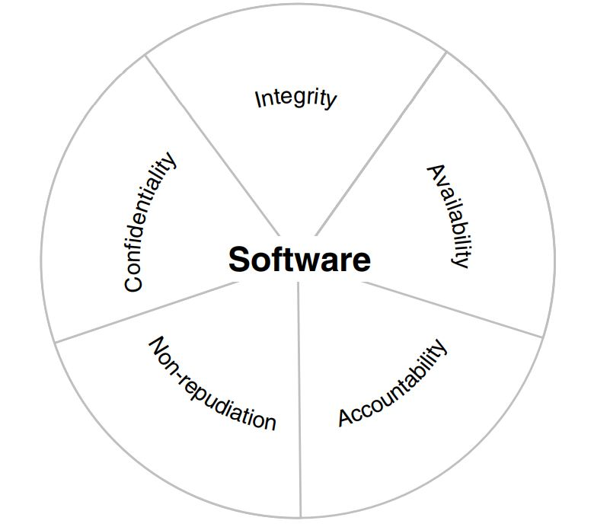
Core Properties of Secure Software
Figure 2.1: Core security properties of secure software

Slide 17
Influential Properties of Secure Software
These are properties of software, although they do not directly make software secure, nevertheless make it possible to characterize how secure software is.
These influential properties are further influenced by the size, complexity, and traceability of the software

Slide 18
Influential Properties of Secure Software
Dependability and Security
Dependability is the property of software that ensures that the software always operates as intended.
Any successful threat to the dependability software results from a fault
Types of Faults:
Development fault: a type of weakness that originates during the software’s development process, i.e., they are “built in” to the software.
Physical fault: a type of weakness that originates in a defect or anomaly in the hardware on which the software runs.
External fault: a type of weakness that originates outside of the software and its hardware platform.
External faults may enter the software as part of user input, variables passed by the environment, messages received from other software, etc.

Slide 19
Influential Properties of Secure Software
Correctness and Security
This is a critical attribute of software that should be consistently demonstrated under all anticipated operating conditions.
Security requires that the attribute of correctness be maintained under unanticipated conditions as well.

Slide 20
Influential Properties of Secure Software
Predictability and Security
Predictability means that the software’s functionality, properties, and behaviors will always be what they are expected to be as long as the conditions under which the software operates (i.e., its environment, the inputs it receives) are also predictable.
For dependable software, this means the software will never deviate from correct operation under anticipated and unanticipated conditions.

Slide 21
Influential Properties of Secure Software
Reliability, Safety, and Security
The focus of reliability for software is on preserving predictable, correct execution despite the presence of unintentional defects and other weaknesses and unpredictable environment state changes.
Software that is highly reliable is often referred to as:
high-confidence software (implying that a high level of assurance of that reliability exists) or
fault-tolerant software (implying that fault tolerance techniques were used to achieve the high level of reliability).

Slide 22
Influential Properties of Secure Software
Reliability, Safety, and Security
Software safety depends on reliability and typically has very real and significant implications if the property is not met.
The consequences, if reliability is not preserved in a safety-critical system, can be catastrophic:
human life may be lost, or
the sustainability of the environment may be compromised.

Slide 23
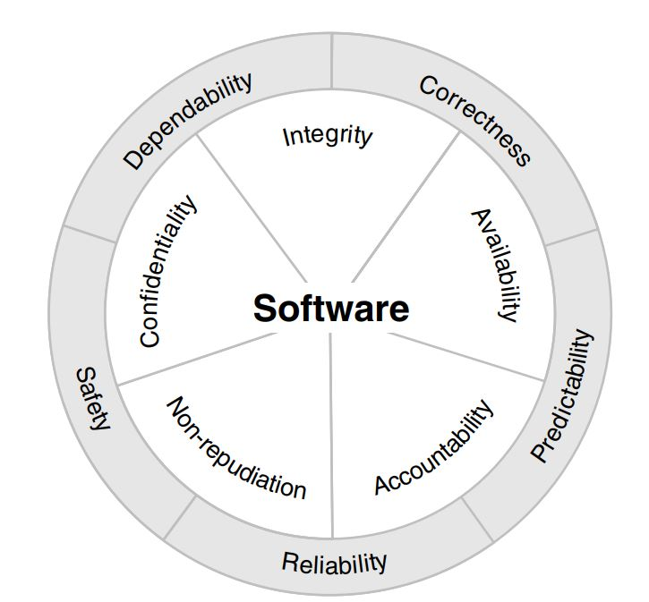
Influential Properties of Secure Software
Figure 2.1: Influential properties of secure software

Slide 24
Security Architecture
Security features and functionality alone are insufficient to ensure software security, but they are a necessary facet to consider.
Security architecture is the overall framework that holds these security functionalities together and provides the set of interfaces that integrates them with the broader software architecture.
Without security architecture and features, adequate levels of confidentiality, integrity, accountability, and non-repudiation may be unattainable.

Slide 25
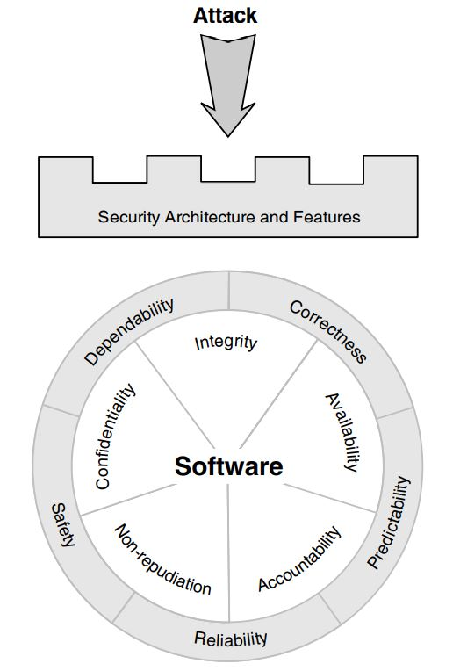
Addressing expected issues with security architecture and features

Slide 26
System Security versus Software Security
System Security focuses on protecting the system’s already-codified operational capabilities and assets.
Software Security ensures that a feature can not simply be “added on” after all of the software’s other features have been codified.
System security measures are both preventive and reactive.
The preventive measures include firewalls and filters, intrusion detection systems, virus scanners, trending and monitoring of network traffic.
Guess the reactive measures?

Slide 27
Security Features != Secure Features
This is to remind us that sprinkling some magic security pixie dust on an application does not make it secure.
We must be sure to include the correct features-and to employ the correct features correctly –to defend against attack.
It’s waste of time using Secure Socket Layer/Transport Layer Security (SSL/TLS) to protect a system if the client/server data stream is not what requires defending.
Give some other reasons why this statement is TRUE!

Slide 28
Holistic View:
Software Security vs. Application Security
Security built into each phase of the SDLC
Security applied by catch and patches
Look at root problem causes
Look at external symptoms
Proactive, Threat Modeling, Secure Code Reviews
Reactive, Incident Response, Compliance
28

Slide 29
PAUSE

Slide 30
Security of Software Systems Built from Components
Because security is an emergent property, it is impossible to predict accurately the security of a software system integrated/assembled from a set of software components (or modules, or programs) by observing the individual behaviours of those components in isolation.
Though static analysis techniques can contribute to the understanding of inter-component interactions and resultant component behaviours
The security of a component assembly or integrated system emerges from the behaviours of all of its components as they interact during the system’s execution.

Slide 31
Risks of insecurity in software systems can be reduced through:
Vetting all acquired or reused and from-scratch components prior to acceptance and integration into the whole system;
Examining interfaces, observation of instances of trust relationships, and implementing wrappers when needed;
Security testing of the system as a whole. If source code is unavailable, the tester should execute as wide a variety of binary object (“black box”) security tests as possible.

Slide 32
Security concerns and use of Acquired or Reused software
These concerns may include the following:
Establishing the security-relevant attributes and assurance levels of candidate software products;
Reliable disclosure of each candidate product’s properties, attributes, and functionalities to other components of the system;
Resolving mismatches between the properties and functionalities of different components;
Establishing aggregate assurance for software systems integrated from components that have different properties and security assurance levels;

Slide 33
Difficulty predicting behaviours of individual components, interactions among components, and interactions between application-level and environment-level components in dynamic environments, such as virtual machines, in which many environmental details are not defined until runtime;
Difficulty determining assurance levels of acquired or reused software that can be reconfigured after the software goes into operational production;

Slide 34
Development Challenges When Using Acquired or Reused Components
For secure integration/assembly of acquired or reused components to be possible:
the system must have a robustly secure architecture, and
the components selected must be thoroughly vetted for their security properties, secure behaviours, and vulnerabilities.

Slide 35
Security Issues Associated with Technological Pre-commitments
Technological pre-commitments, while they may achieve better interoperability and economy of scale across the organization, must be examined thoroughly (using data from a risk analysis) to ensure that the system satisfies its security and other requirements.
For instance, business requirements (e.g., the need to provide users with remote access to required information)

Slide 36
Regardless of the rationale behind technological pre-commitments, they should be reviewed to determine whether:
Any particular requirements should be rewritten to ensure they can be satisfied within the constraints imposed by those pre-commitments;
Any additional requirements need to be added to mitigate any known vulnerabilities that use of the pre-committed technologies/products may introduce.

Slide 37
Security Concerns with Outsourced and Offshore-Developed Software
A major security challenge associated with acquisition of commercial software, open source software, and other software of unknown pedigree (SOUP) is how to determine that such software has not been developed by criminal elements or entities hostile to Organisation.

Slide 38
Questions??

